Slide 1

SQL Project on Pizza Sales
- Piyush Rajput

Slide 2
INTRODUCTION
"The goal of this project is to analyze pizza sales data to identify trends, understand customer preferences, and optimize inventory management. By utilizing SQL, my aim to provide actionable insights that can drive business growth.“
In this project, I have utilized SQL Query to solve questions that were related to Pizza Sales.

Slide 3
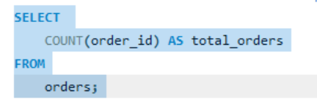
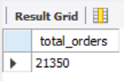
1. Retrieve the total number of orders placed
Query
Output

Slide 4
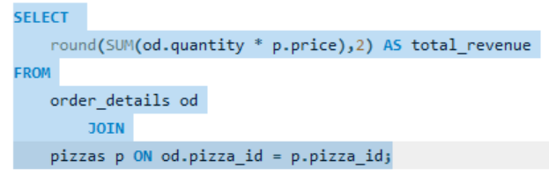
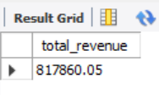
2. Calculate the total revenue generated from pizza sales
Query
Output

Slide 5
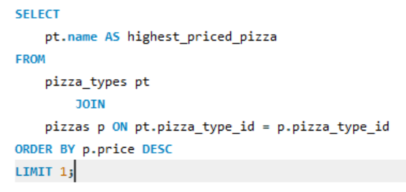
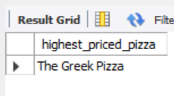
3. Identify the highest-priced pizza
Query
Output

Slide 6
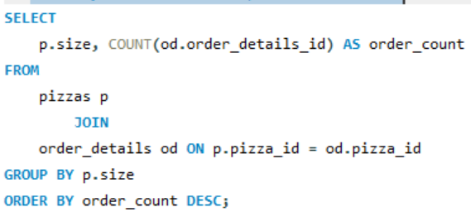
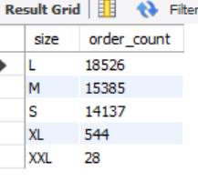
4. Identify the most common pizza size ordered
Query
Output

Slide 7
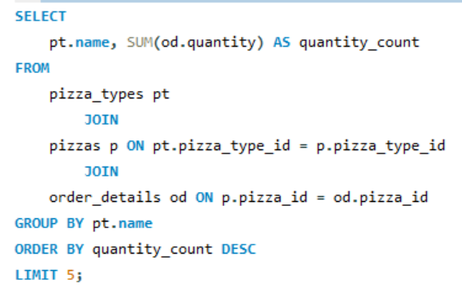
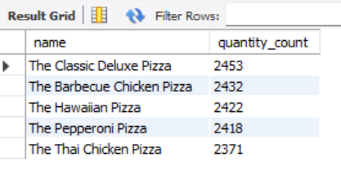
5. List the top 5 most ordered pizza types along with their quantities
Query
Output

Slide 8
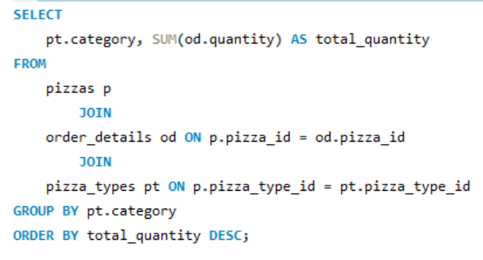
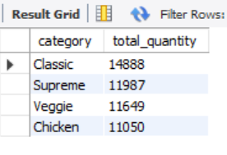
6. Join the necessary tables to find the total quantity of each pizza category ordered
Query
Output

Slide 9
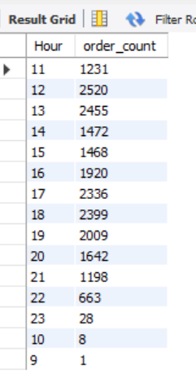
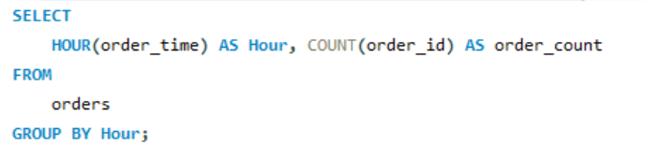
7. Determine the distribution of orders by hour of the day
Query
Output

Slide 10
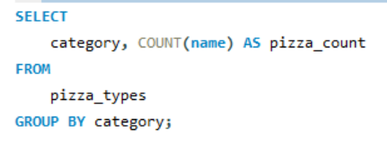
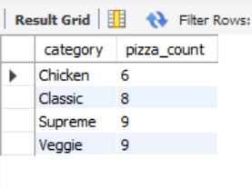
8. Join relevant tables to find the category-wise distribution of pizzas
Query
Output

Slide 11
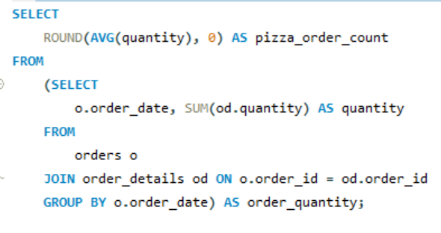
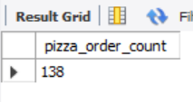
9. Group the orders by date and calculate the average number of pizzas ordered per day
Query
Output

Slide 12
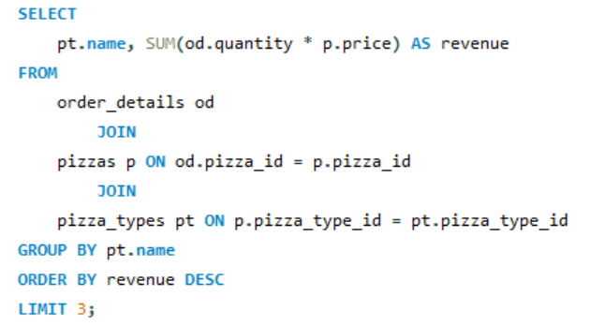
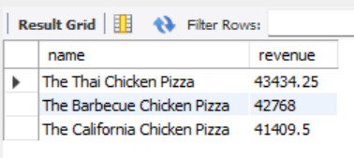
10. Determine the top 3 most ordered pizza types based on revenue
Query
Output

Slide 13
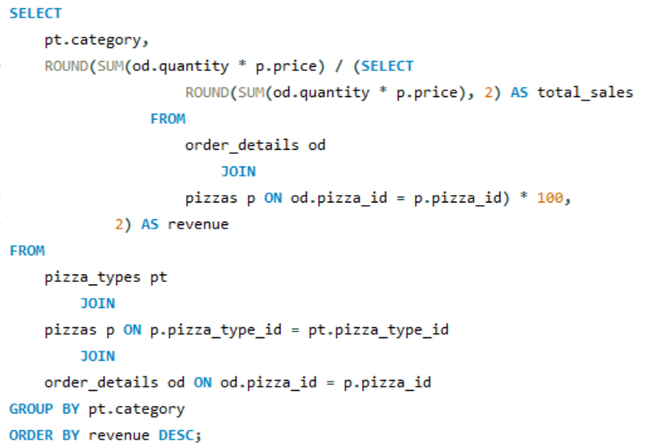
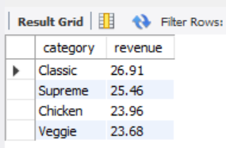
11. Calculate the percentage contribution of each pizza type to total revenue
Query
Output

Slide 14
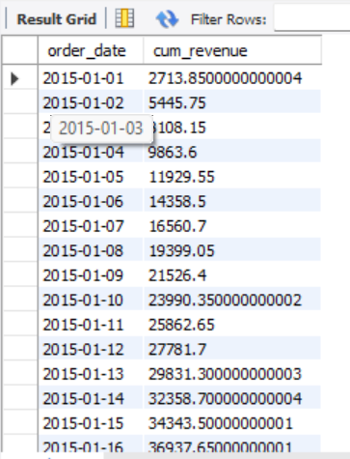
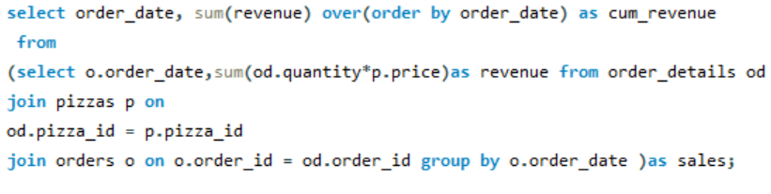
12. Analyze the cumulative revenue generated over time
Query
Output

Slide 15
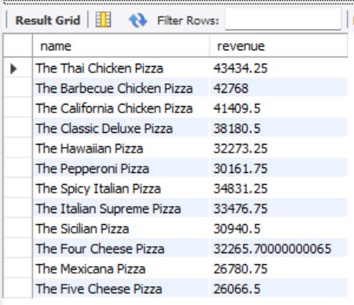
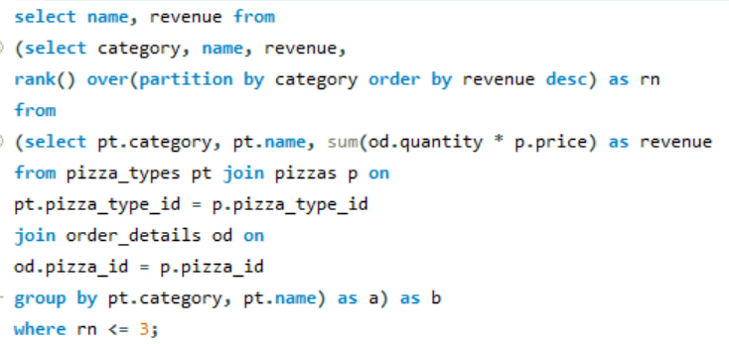
13. Determine the top 3 most ordered pizza types based on revenue for each pizza category
Query
Output

Slide 16


